Slide 1

PREMIER UNIVERSITY, CHITTAGONG
Department of Computer Science & Engineering
TOLL GATE SYSTEM USING ARDUINO UNO
PREPARED BY:
NAME: TAMANNA ISLAM
ID: 1903710201974
NAME: KRITTIKA BARUA
ID:1903710201977
NAME: BISWAJIT MALLICK
ID:1903710201978
NAME: ASMA BINTE RASHID
ID:1903710201982

Slide 2
Content
Introduction.
Idea Behind this work.
Apparatus.
Circuit Diagram.
Experimental setup.
Flow Chart
Working Principle
Project Final Output
Conclusion
Future Work

Slide 3
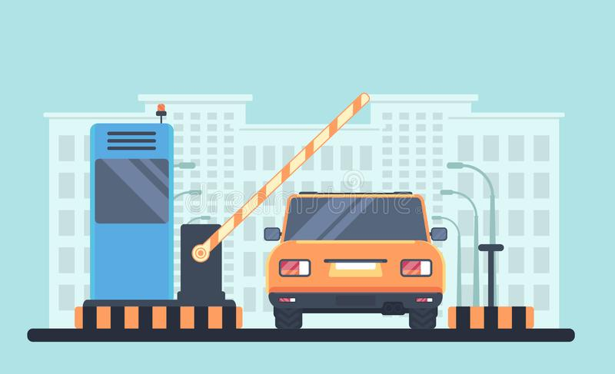
Introduction
Automation has a great impact on our everyday life and making our life easy. Day by day the number of vehicles passing over the road is increasing due to which traffic jam; wastage of human effort is taking place. We make a fully automated toll collection system using Arduino which is able to reduce human effort and time and most importantly traffic jam. In this project, we are making an exact replica found in toll plaza centers that is called as stopping system, The idea for this project was inspired from actual system, in actual toll they stop the vehicles using a stopper that is completely automated and it is activated when any vehicle passes in front the sensor, or some time it’s activated through a button. The most excellent advantage of this system is that it is capable of eliminate congestion in toll plaza, especially during those seasons when traffic seems to be higher than normal
In our case, we are using an HC-SR04 or called as ultrasonic distance sensor to detect an obstacle(vehicle) and later to lift the barrier we are using micro servo, that is the mechanism involved in this project, Now let us dive into the building stage

Slide 4
Idea Behind This Work
The main objective behind this proposal is to create a suitable Automatic Toll Collection system to be implemented. We are implementing ARDUINO Based Toll System is to automate the toll collection process and save time .In addition to collecting toll, it not only helps the vehicle owners and system administrators from vehicle theft detection but also can track over speeding vehicles, and crossing the signals. Automatic Toll Collection system using ARDUINO in our day to day life avoids the fuel loss, saves time in collecting toll, avoids financial loss and monitors the traffic.

Slide 5
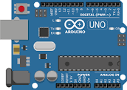
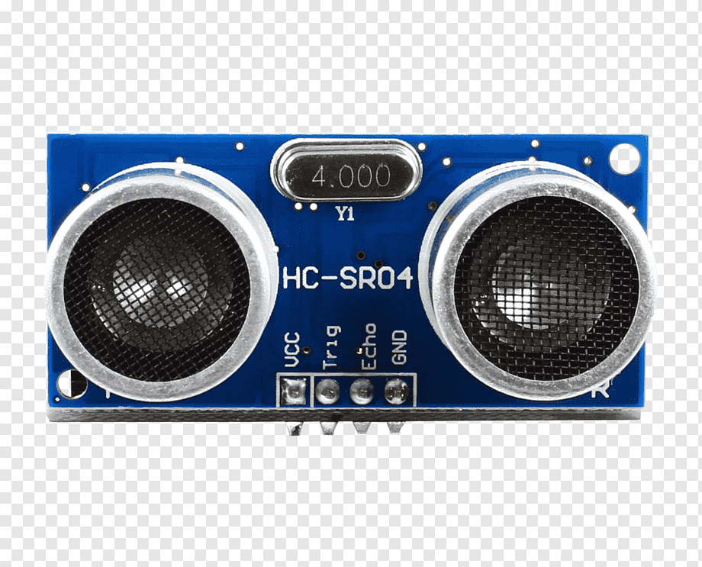
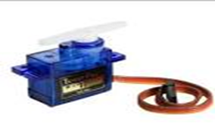
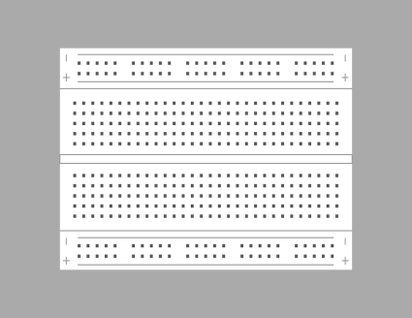
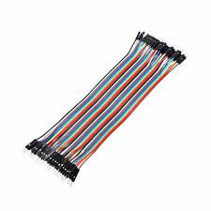
Apparatus
1 ARDUINO UNO 2. ULTRASONIC SENSOR 3. SERVO MOTOR
4 .BREADBOARD 5.JUMPER WIRES

Slide 6
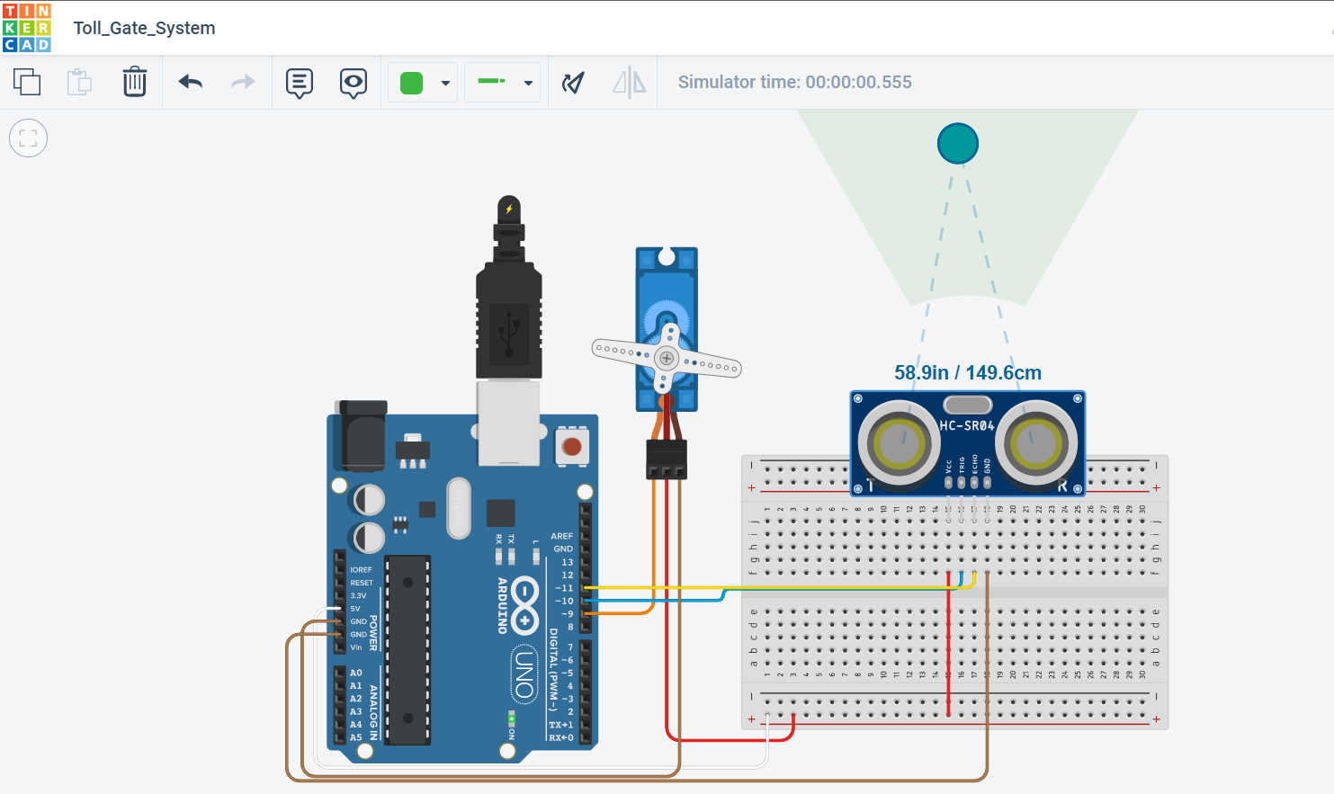
Connection Diagram

Slide 7
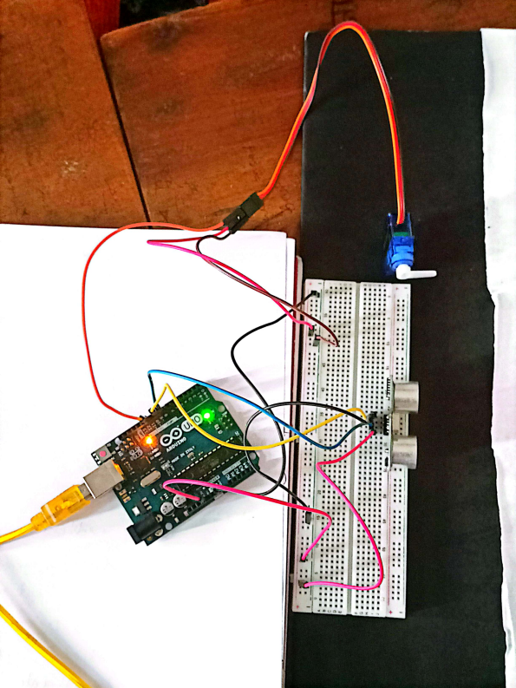
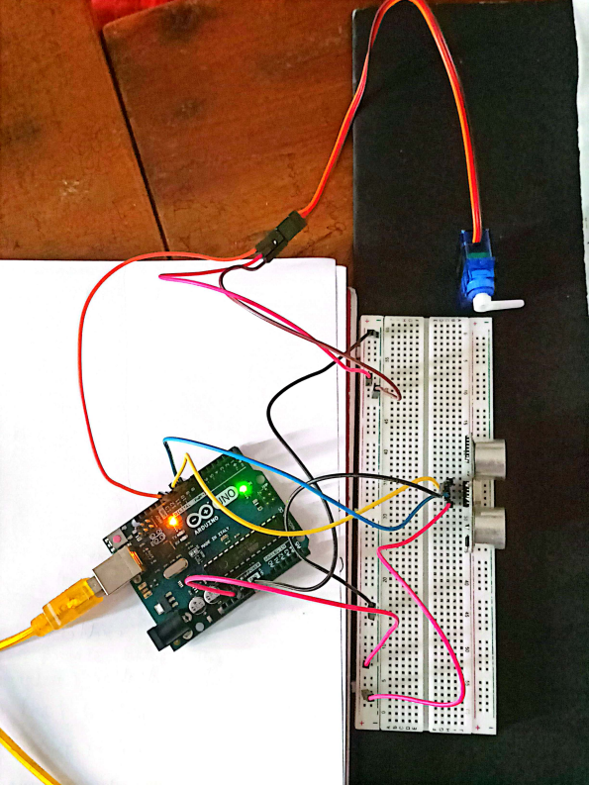
Experimental Setup

Slide 8
Flow Chart
Start
VEHICLE ENTER THE TOLL PLAZA
DETECTOR READ THE TAG
DETECT VEHICLE?
NO
YES
TOLL GATE OPENS
GATE REMAINS CLOSE
VEHICLE CROSS THE TOLL PLAZA
END

Slide 9
Working Principle
In this project, we use ultrasonic sensor is used to measure the distance between objects. Here, ultrasonic sensor is placed near the gate which will be raised/lowered when vehicle arrives and closed as vehicle departs Gate is attached directly to the shaft of micro Servo whenever obstacle is detected by sensor, signals will be sent to Arduino board Shaft of micro Servo lifts by 180° and the tollbooth will open and let a car pass. We can also change the various parameters like the angle which should be raised by the micro servo also At what distance ultrasonic sensor should start sending signal to the Arduino Nano or time of lifting and lowering barrier.

Slide 10
Working Principle
ARDUINO UNO
POWER SUPPLY
VEHICLES
ULTRASONIC SENSOR
SERVO MOTOR
PC/LAPTOP
Figure: Working principle of Toll Gate

Slide 11
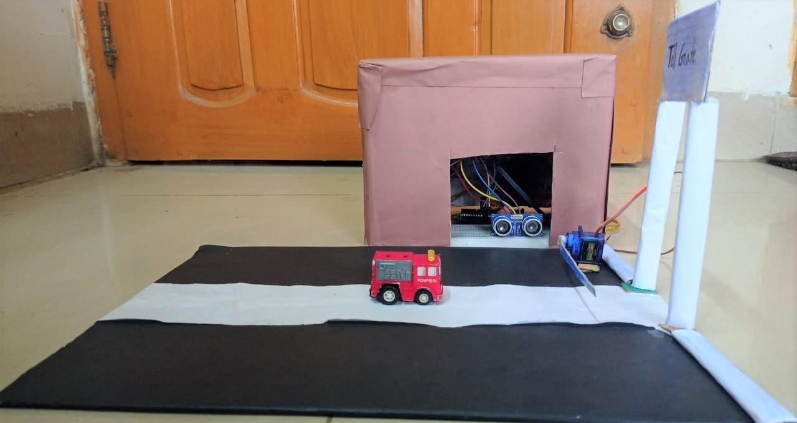
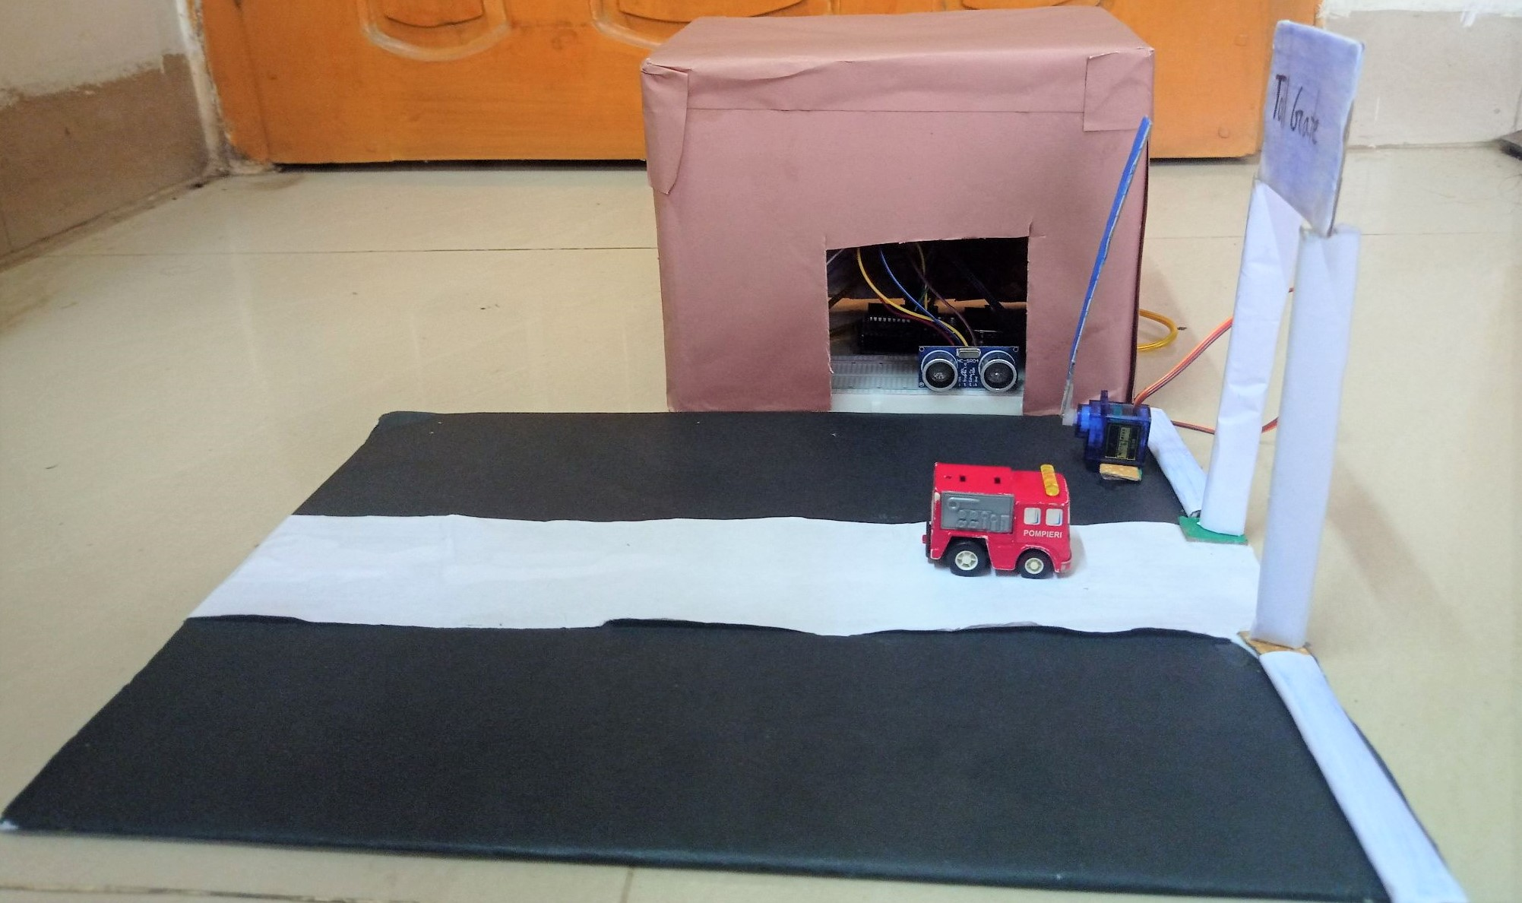
Output

Slide 12
Conclusion
The implementation of Automatic Toll Collection system-
Significantly contribute to improve travel conditions by addressing delay. People hate delay at tollbooths . This system collects toll from vehicles driving on toll roads without making the vehicle stop at Tollbooth . These systems include benefits to both toll authorities and facility users , in term of time and cost saving, improve security and greater convenience .

Slide 13
Future work
Instead of a prepaid amount, we can have post paid mechanism where the user doesn’t have to stop at the toll booth to deduce the balance from the account and a bill is generated at the end of the month.
With online application using internet facilities, person can directly pay the bill.
In case of violation of rules, they can be charged a fine accordingly for not paying taxable amount.
This prevents the vehicle from stopping at tollbooth and helps in reduction of congestion at toll plaza . This will ensure a faster flow of traffic and conserve a lots of time .

Slide 14
Thank you

